Slide 1
SALES DATA
Presented by
VAISHNAVI V

Slide 2
OBJECTIVE
To provide a comprehensive and interactive overview of sales performance across products, channels, customers, and regions .
enabling stakeholders to quickly assess total revenue, order quantities, profitability, and cost patterns.
The dashboard supports data-driven decision-making by identifying top-performing products, key revenue channels, high-value customers, and geographical sales distribution.

Slide 3
METHODOLOGY
Data extracting
Data cleaning
Data analysis
DATA MODELLING
Dax functions
Power bi dashboard

Slide 4
DATASET OVERVIEW
It contain 4 tables they are:
Sales data
Customer data
Product data
Region data

Slide 5
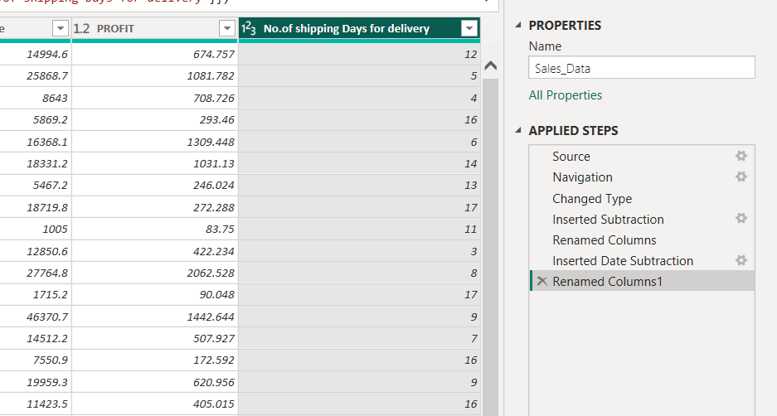
DATA CLEANING
Data cleaning is done using power query editor

Slide 6
DAX FUNCTIONS
TOTAL revenue = SUM(Sales_Data[Total Revenue] )
total quantity = SUM(Sales_Data[Order Quantity] )
MaxIMUM unit price = MAX(Sales_Data[Unit Price] )
minIMUM unit price = MIN(Sales_Data[Total Unit Cost])
avERAGE VALUE OF total unit cost = AVERAGE(Sales_Data[Total Unit Cost])
unique products = DISTINCTCOUNT(Products_Data[Product Name])
No.of Orders = COUNT(Sales_Data[OrderNumber])

Slide 7
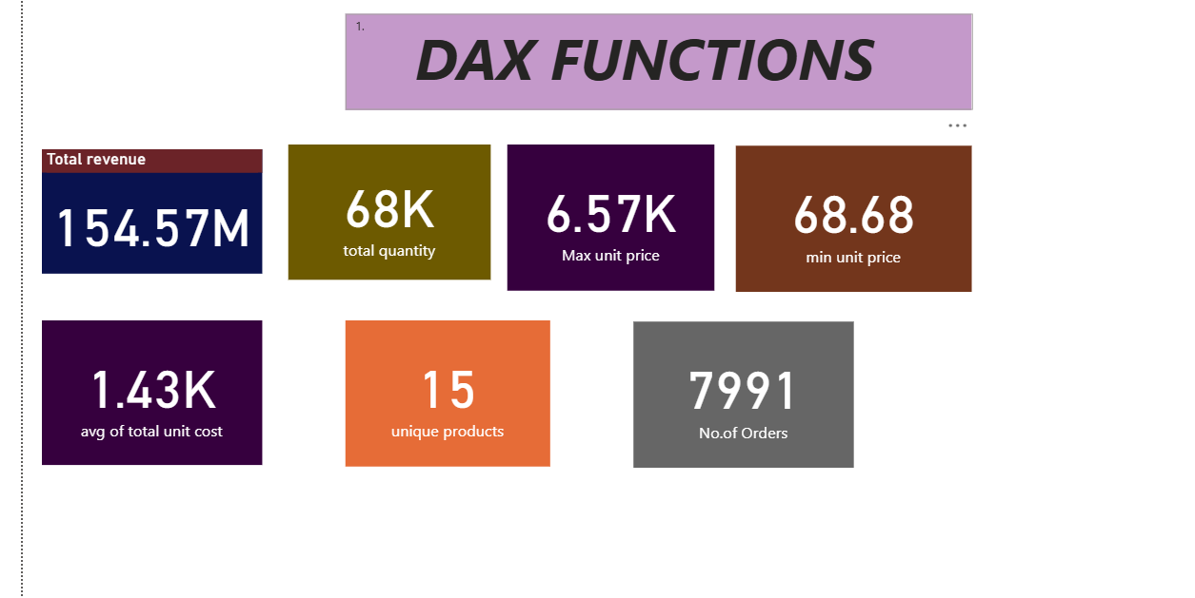
DAX FUNCTIONS

Slide 8
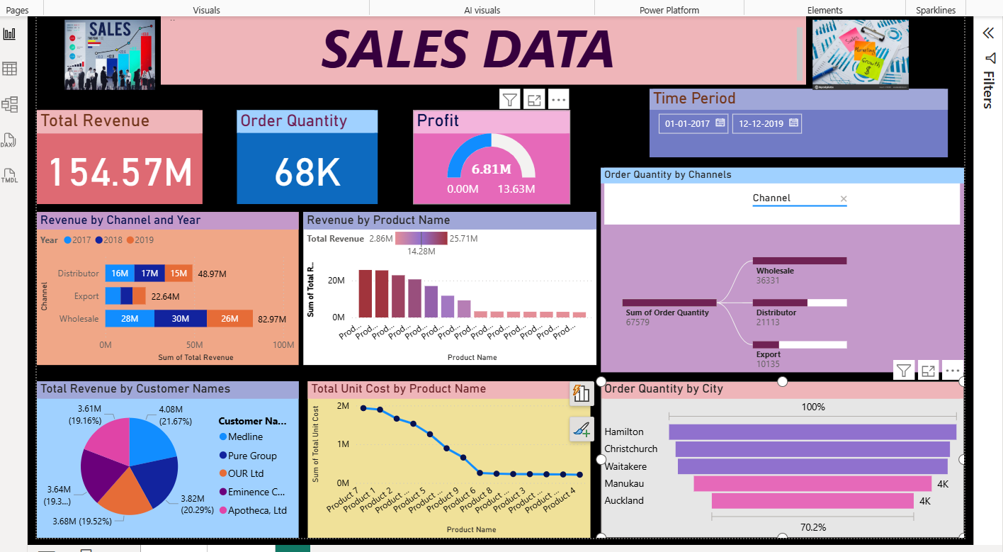
DASHBOARD OVERVIEW
.

Slide 9
DASHBOARD OVERVIEW
The Sales Data Dashboard presents a consolidated view of business performance from 2017 to 2019, tracking key metrics such as total revenue (154.57M), order quantity (68K), and profit (6.81M). It breaks down revenue trends by channel (Wholesale, Distributor, Export), product performance, customer contributions, and regional order distribution.
Revenue by Channel & Year: Highlights Wholesale as the largest contributor, followed by Distributor and Export.
Product Analysis: Shows top revenue-generating products and their associated unit costs.
Customer Segmentation: Pie chart of revenue share by top customers.
Geographical Insights: Bar chart of order quantities by city, with Hamilton leading.
Order Quantity by Channel: Shows volume split among Wholesale, Distributor, and Export.

Slide 10
KEY INSIGHTS
Profit: 6.81M (~44% of the target 13.63M) – indicating potential for improvement.
Wholesale is the highest revenue contributor (82.97M over 3 years).
Distributor and Export channels are much smaller in comparison, with Export being the lowest (22.64M).
Revenue slightly dropped in 2019 for Wholesale and Distributor.
Top 3 products contribute a majority of revenue, with the highest earning product generating 25.71M.
Pure Group (21.67%) and Apotheca, Ltd (20.29%) are top customers.
Hamilton has the largest share, followed closely by Christchurch and Waitakere, while Manukau and Auckland have smaller order volumes.

Slide 11
RECOMMENDATIONS
Profit Improvement:
Investigate cost structures for top products.
Review pricing strategy for low-margin items.
Channel Diversification:
Focus on growing Export and Distributor sales to reduce reliance on Wholesale.
Product Optimization:
Consider discontinuing or repositioning low-revenue items.
Push marketing for high-margin, mid-tier revenue products.
Geographic Expansion:
Launch targeted campaigns in Manukau and Auckland.
Yearly Trend Monitoring:
Address the dip in 2019 through promotions, or market reactivation strategies.

Slide 12
CONCLUSION
Wholesale is the main revenue and order driver.
A few products and customers are consistent top pERFORMERS.
Profit is significantly below the target, suggesting cost management or pricing issues.
Heavy dependency on a few channels and customers increases business risk.
Several products contribute very little revenue — these may require reevaluation.
Expand sales in Export and Distributor channels to reduce dependency on Wholesale.
Optimize or phase out low-performing products.
Target cities like Auckland and Manukau for growth campaigns.

Slide 13
Thank you

